Slide 1
Chongqing University of Technology
ATAI
Advanced Technique of Artificial Intelligence
Chongqing University of Technology
Using the Past Knowledge to Improve Sentiment Classification（EMNLP 2020 ）
Code:https://github.com/Qqinmaster/L2PG
彭展望

Slide 2
Outline
Introduction
Method
Experiment
Conclusion

Slide 3
Introduction
Problem Definition:
Notes:
在这里，知识选择是至关重要的，因为并不是所有过去的知识都对新任务有用(有些甚至有害)。第二个目标是在学习新任务的过程中保存过去学习过的知识，因为如果在学习新任务的过程中，许多以前的知识被破坏了，以后的任务将无法从中受益

Slide 4
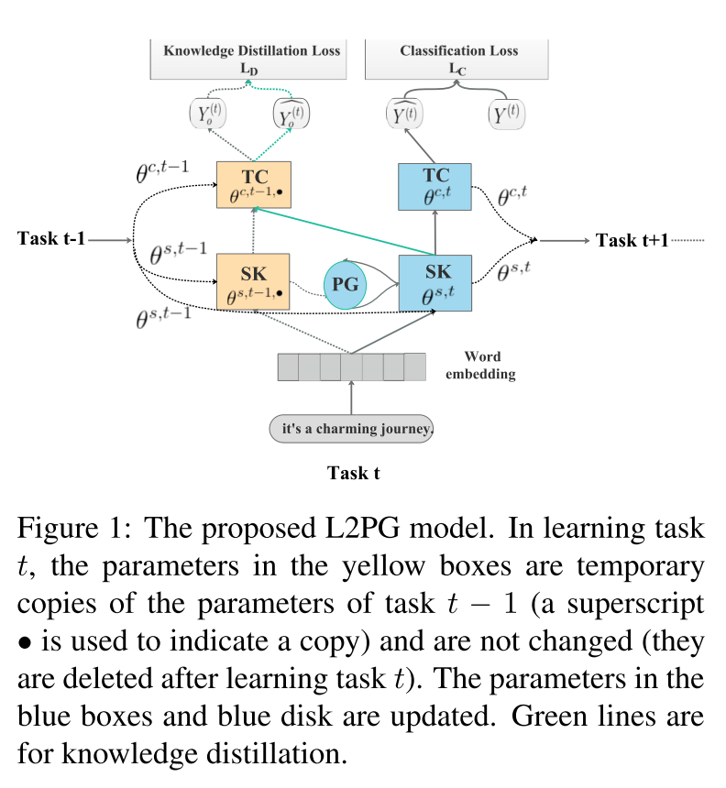
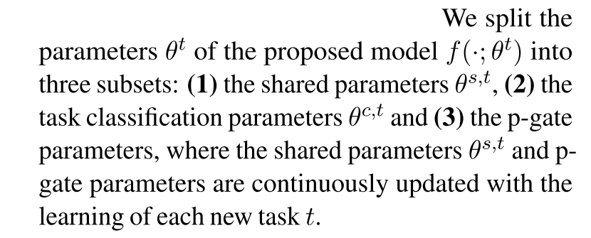
Method

Slide 5
Method
Shared Knowledge Module (SK)：
$$W^{t}∈R^{n×k}$$
$$b^{t}∈R$$
g is Relu
Notes:
g is Relu

Slide 6
Task Classification Module (TC):

Slide 7
P-Gate Module (PG):
input p-gate:
block p-gate:

Slide 8
Objective of Optimization:
Knowledge Distillation Loss:
Classification Loss:
total loss:

Slide 9
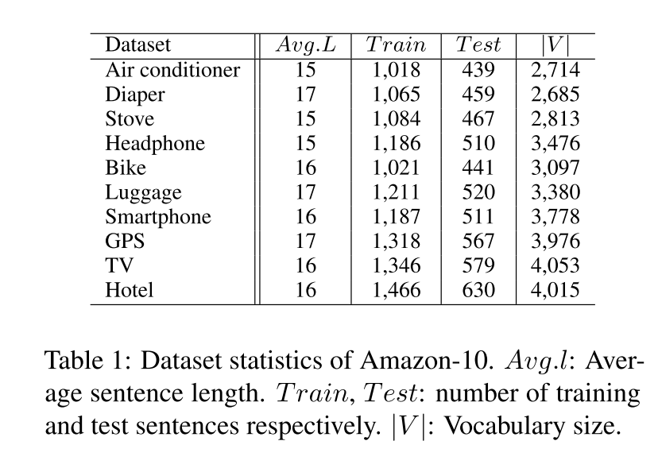
Dataset

Slide 10
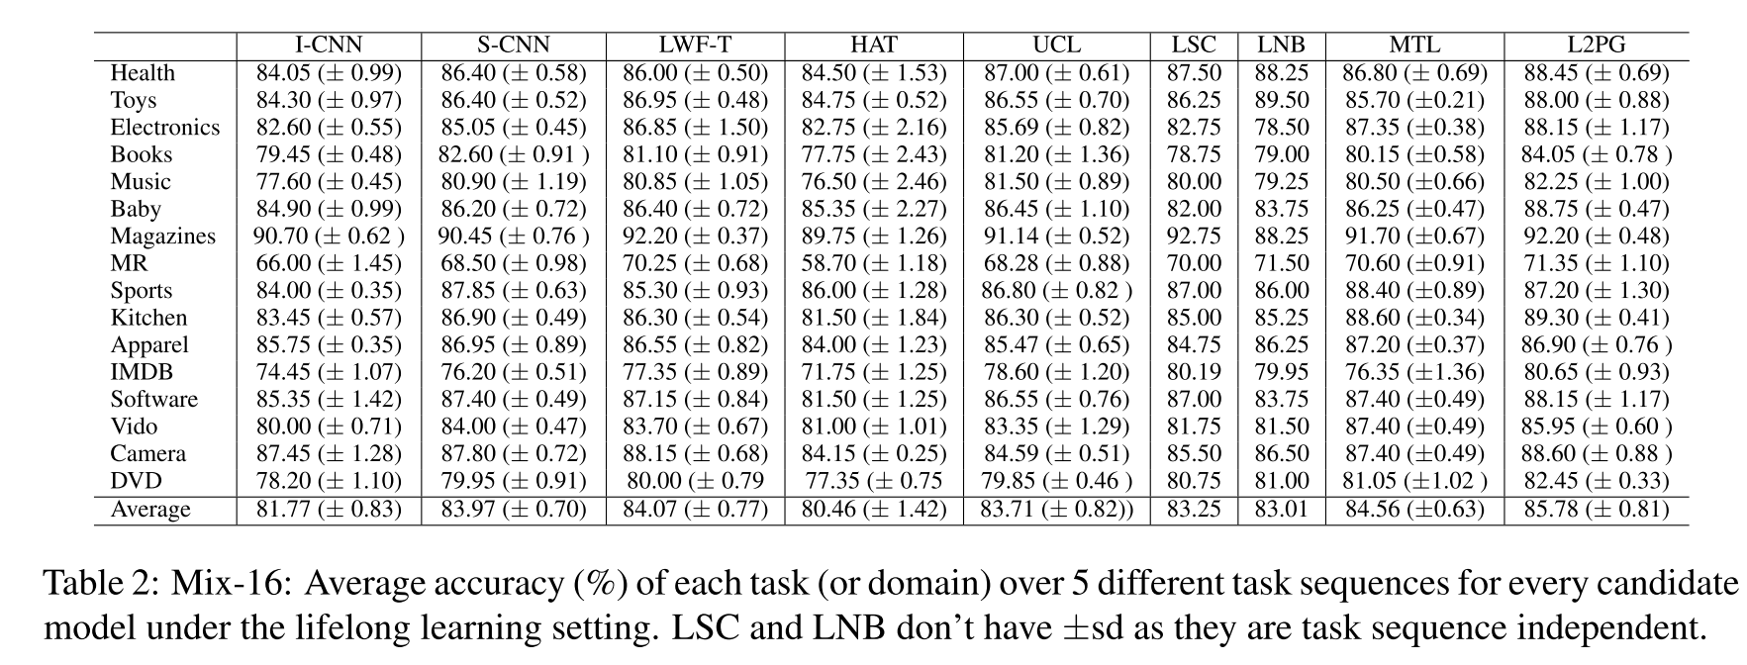
Experiment

Slide 11
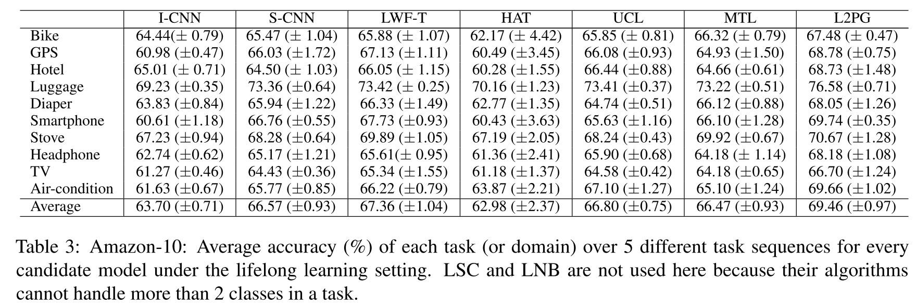
Experiment

Slide 12
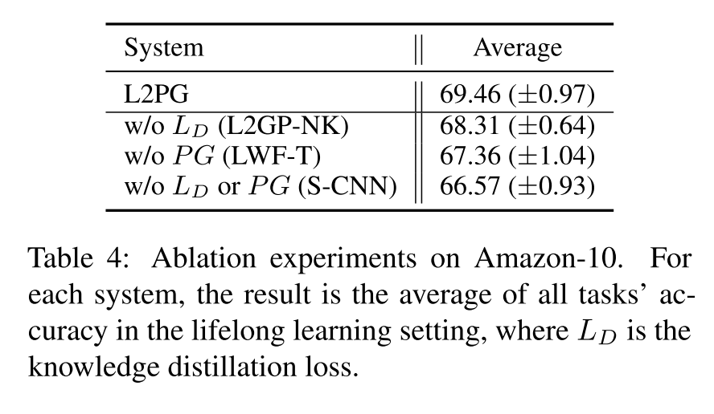
Experiment

Slide 13
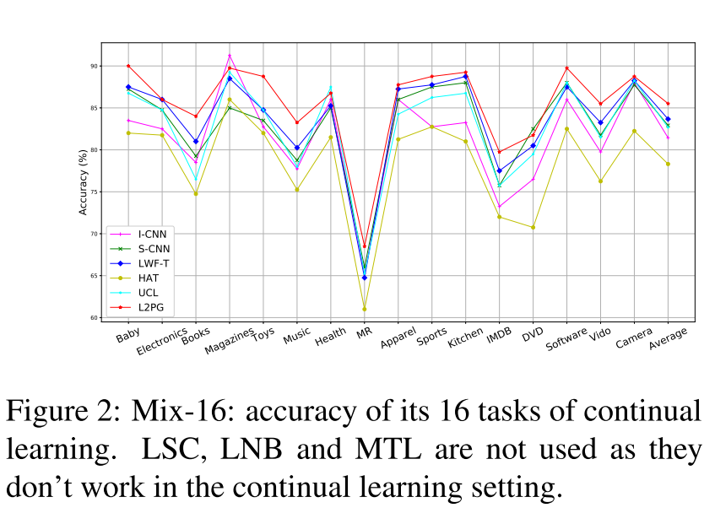
Experiment

Slide 14
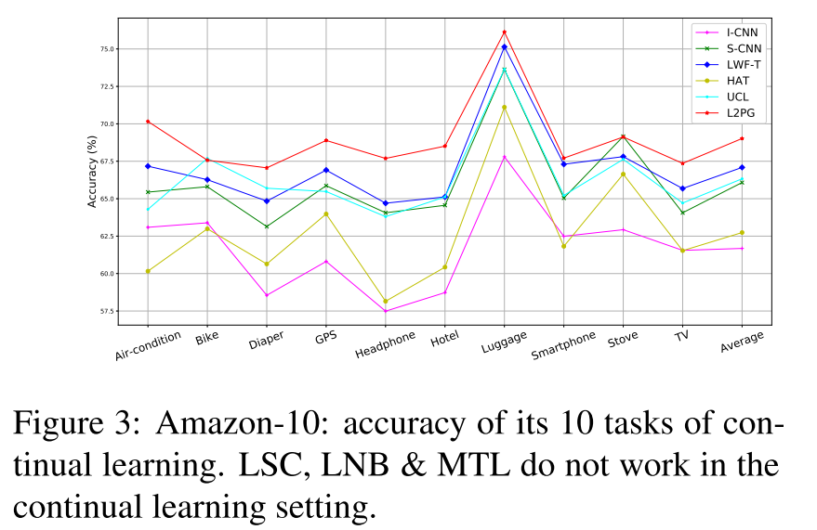
Experiment

Slide 15
Thanks

